Slide 1
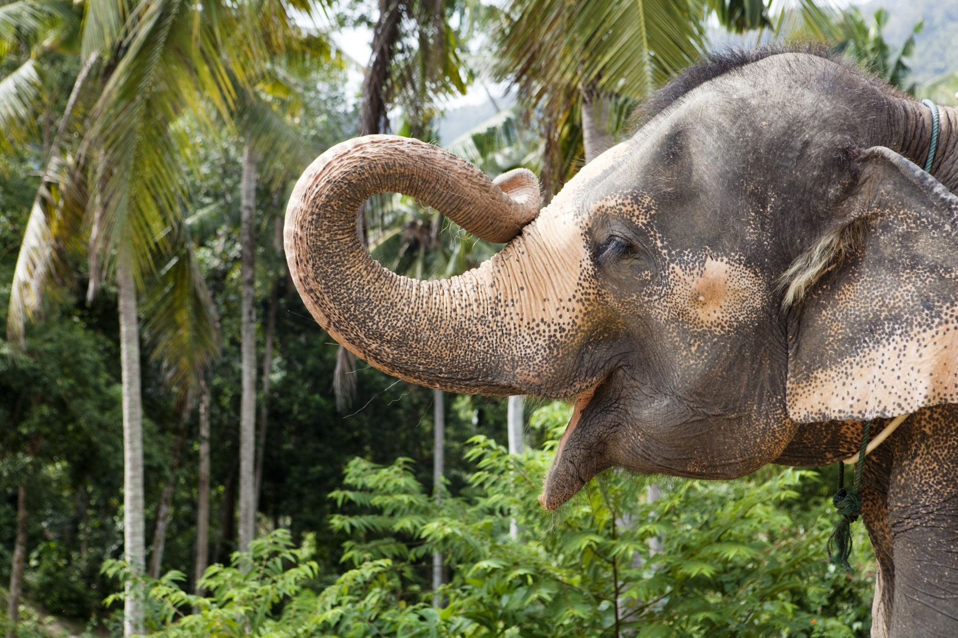


Comparative Analysis of Vision Transformer (VIT) vs. Convolutional Neural Network (CNN) on African vs. Asian Elephants Dataset
Ariel Lulinsky and Hadar Hai
ECE 046211 Final Project

Slide 2


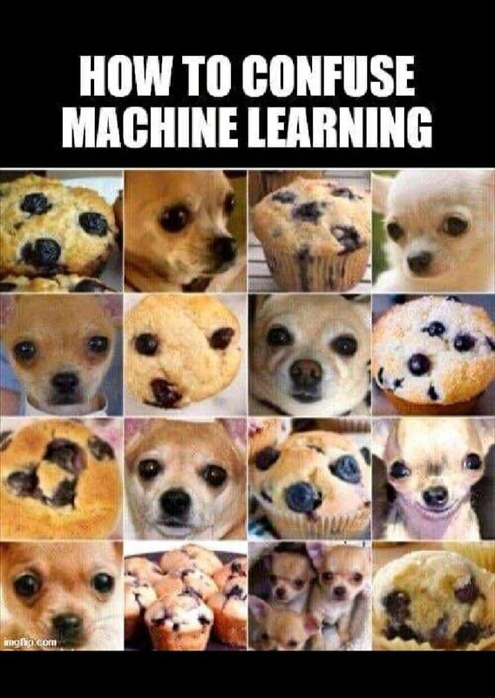
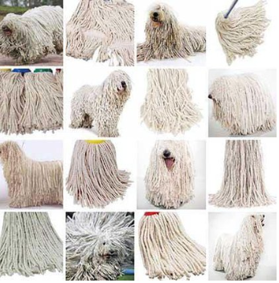
Introduction
82.3%*
This project aims to compare the effectiveness of Convolutional Neural Networks (CNN) and Vision Transformers (ViT) in binary image classification, particularly in distinguishing between Asian and African elephants, visually similar classes.
This issue is also found in other datasets, such as Japanese art vs. art Nouveau, cats vs. rabbits, sheepdogs and mops, muffins vs. chihuahuas, and more…
This type of classification task poses a significant challenge, even for humans to accomplish.
* https://www.kaggle.com/code/luthei/vit-vs-cnn-on-wikiart

Slide 3






Efficient Image Processing
Limited Global Context
Excels at processing images efficiently through convolutional layers.
Processes local regions, leading to limited global context understanding.
Hierarchical Feature Learning
Heavy Parameter Footprint
CNN
Learns hierarchical representations for robust feature extraction.
Requires many parameters, leading to increased memory usage and longer training times.
State-of-the-Art Performance
Achieves remarkable success in various computer vision benchmarks.
https://www.upgrad.com/blog/basic-cnn-architecture/
Global Context Understanding
High Computational Cost
Processes the entire image, capturing long-range dependencies and global context.
Training can be computationally expensive due to a large number of parameters and self-attention mechanisms.
Self-Attention Mechanism
Data Efficiency
ViT
Utilizes self-attention mechanisms for focusing on relevant parts of the image.
Requires substantial amounts of data for effective training, limiting performance on smaller datasets.
Transferability and Pretraining
Can be pretrained on large-scale datasets and fine-tuned for various vision tasks.
Vaswani, Ashish & Shazeer, Noam & Parmar, Niki & Uszkoreit, Jakob & Jones, Llion & Gomez, Aidan & Kaiser, Lukasz & Polosukhin, Illia, “Attention is all you need” , 2017.
Notes:
© Copyright PresentationGO.com – The free PowerPoint and Google Slides template library

Slide 4

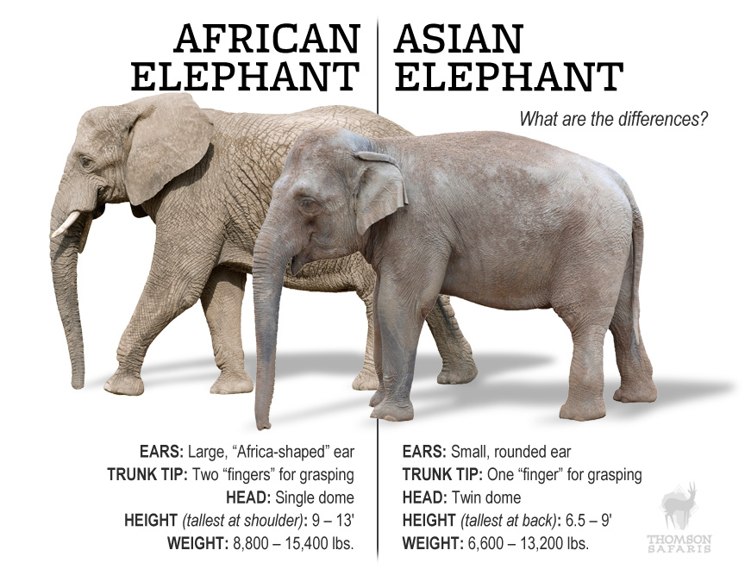
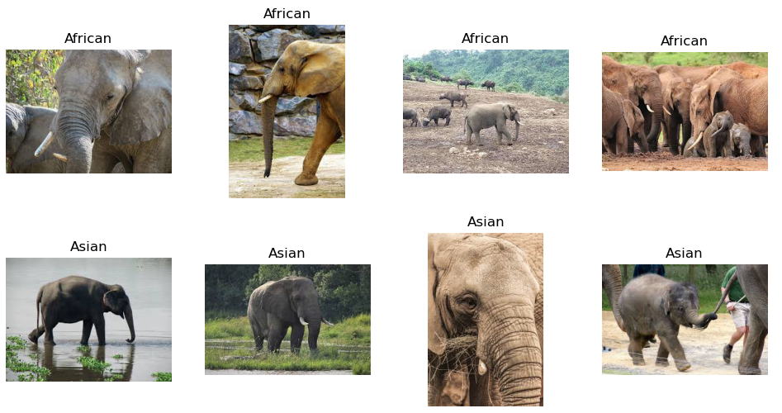
Dataset Description
Dataset of 1028 images
% of total | Asian | African
70 % | 369 | 369 | Train
10 % | 51 | 51 | Validation
20 % | 91 | 97 | Test
https://thomsonsafaris.com/blog/difference-african-asian-elephant/

Slide 5
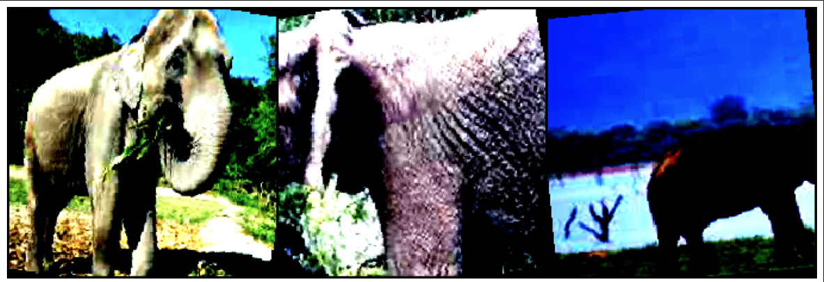

Data Preprocessing – augmentation using Kornia
Random resize and crop to 224 x 224
Random rotation -10:10 degrees
Random horizontal flip
Random affine, zoom 10%
Normalize with mean and std of Imagenet
Methodology

Slide 6
Methodology
SGD optimizer with learning rate of 0.001 and momentum of 0.9
Cross entropy loss function
Find the best CNN checkpoints
Checkpoint | Pretrained Model Name | Batch Size | Epochs | FE/FT | Use LoRA/ DoRA | Validation Accuracy | Why
1 | Mobilenet V2 | 32 | 20 | FE | No | 71% | Found best in previous works
2 | Mobilenet V3 Small | 32 | 20 | FE | No | 75%
3 | Mobilenet V3 Small | 64 | 20 | FE | No | 75%
4 | Mobilenet V3 Small | 128 | 20 | FE | No | 73%
5 | Mobilenet V3 Large | 32 | 20 | FE | No | 77%
6 | RESNET50 | 32 | 20 | FE | No | 74% | Same network as for Wikiart *
7 | Mobilenet V3 Large | 32 | 20 | FE | LoRA | 75% | The best so far from MN using FE
8 | Mobilenet V3 Large | 32 | 20 | FE | DoRA | 73% | The best so far from MN using FE
9 | Mobilenet V3 Large | 32 | 20 | FT | No | 75% | The best so far from MN using FE, LoRA or DoRA didn’t make an improvement
10 | RESNET50 | 32 | 20 | FT | No | 76%
* https://www.kaggle.com/code/luthei/vit-vs-cnn-on-wikiart

Slide 7
Methodology
SGD optimizer with learning rate of 0.001 and momentum of 0.9
Cross entropy loss function
Find the best CNN checkpoints
Checkpoint | Pretrained Model Name | Batch Size | Epochs | FE/FT | Use LoRA/ DoRA | Validation Accuracy | Why
1 | Mobilenet V2 | 32 | 20 | FE | No | 71% | MobileNet variants
2 | Mobilenet V3 Small | 32 | 20 | FE | No | 75%
3 | Mobilenet V3 Large | 32 | 20 | FE | No | 77%
4 | Mobilenet V3 Large | 32 | 20 | FE | LoRA | 75% | LoRA/DoRA/FT
5 | Mobilenet V3 Large | 32 | 20 | FE | DoRA | 73%
6 | Mobilenet V3 Large | 32 | 20 | FT | No | 75%
7 | RESNET50 | 32 | 20 | FE | No | 74% | Same network as for Wikiart*
8 | RESNET50 | 32 | 20 | FT | No | 76%
* https://www.kaggle.com/code/luthei/vit-vs-cnn-on-wikiart

Slide 8
Methodology
Compare the two best CNN checkpoints to two ViT checkpoints
Checkpoint | Pretrained Model Name | Batch Size | Epochs | FE/FT | Use LoRA/ DoRA | Validation Accuracy | Test Accuracy | Why
5 | Mobilenet V3 Large | 32 | 20 | FE | No | 77% | 86% | Found best in previous works
10 | RESNET50 | 32 | 20 | FT | No | 76% | 88% | Popular
11 | ViT-base-16 | 32 | 20 | FE | - | 83% | 90% | Supervised
12 | ViT-dino-V2 | 32 | 20 | FE | - | 84% | 94% | Self-supervised
* https://www.kaggle.com/code/luthei/vit-vs-cnn-on-wikiart

Slide 9
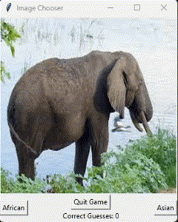
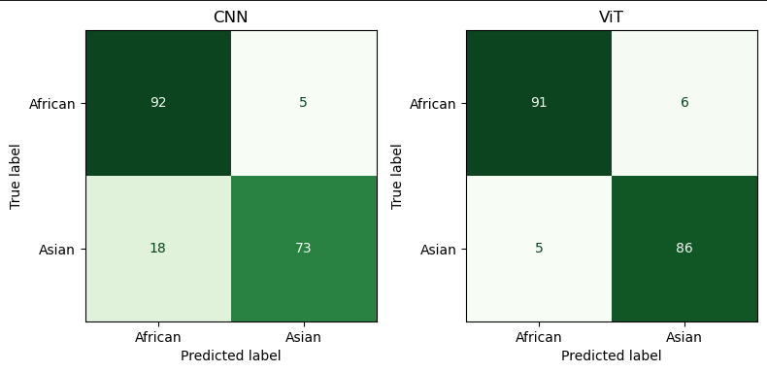
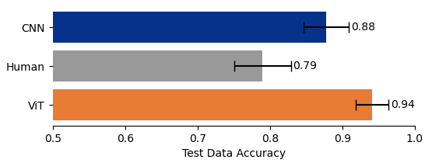
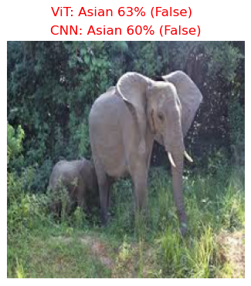
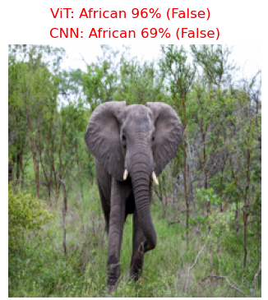
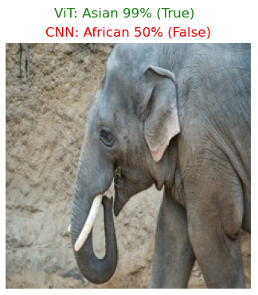
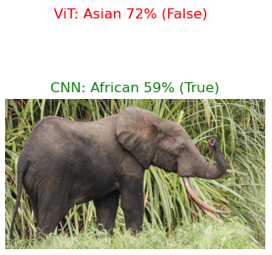
Results
Wrong classification
Wrong test pre-labeling

Slide 10
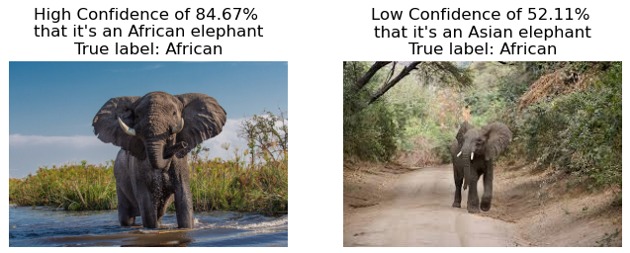
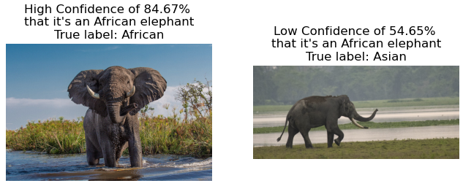
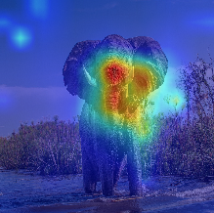
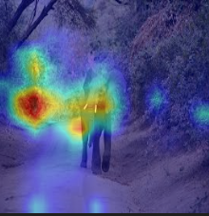
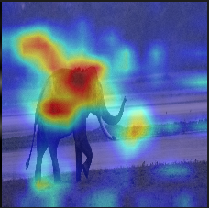
CNN Results

Slide 11
Discussion & Conclusion
Mobilenet V3 Large (Checkpoint 5): Despite its lightweight nature, achieved competitive accuracy, showcasing its efficiency in resource-constrained environments.
The results show that CNN performance aligns closely with the baseline*.
The ViT models perform better than the two CNN models, and self-supervised ViT models achieve the highest accuracy. This supports our hypothesis that ViT excels in capturing spatial relationships. Self-supervised ViT models, proven effective in many tasks, outperform the supervised one.
ViT's effectiveness is largely attributed to training on extensive datasets. Training a model from scratch with a small dataset would likely yield poor results, with CNNs still expected to outperform ViT. This underscores the importance of dataset size and pretraining strategies for ViT model performance.
*https://www.kaggle.com/code/nasruddinaz/elephclass-asian-vs-african-elephants-classifier

Slide 12
Thank you!
Q&A

